Slide 1
Experiencing a11y
An Intro to Web Accessibility

Slide 2

Types of adaptive tools

Slide 3
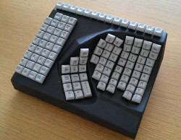
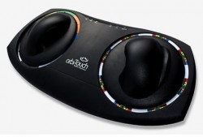
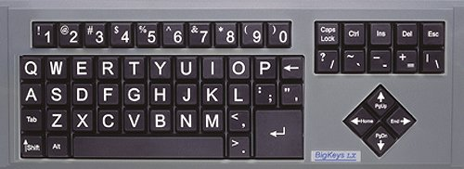
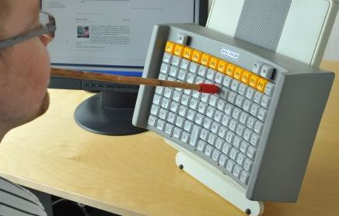


Slide 4
Screen Reader Instructions
NVDA (Windows)
Voice Over (Mac)
To Turn On:
Start App
Keep Default Settings
Screen Reader is now running. Ensure your sound is loud enough to hear.
To Turn Off:
Right Click app from task bar and click “Exit”

Slide 5
Switch
An adaptive switch, alters the interaction scheme between the user and the device making a previously inaccessible method (the buttons are too small and inaccessible for persons with poor motor skills) accessible by using a movement pattern or skill that the person with a disability can more easily perform. *www.c3schools.org/MHEC/WebCT/Adaptive_Switches.doc

Slide 6
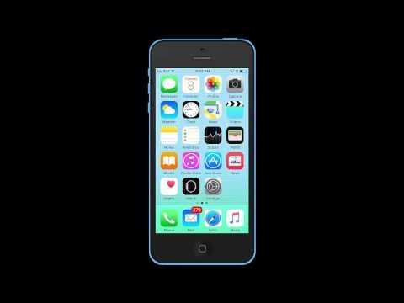
Switch for iOS devices
Settings > General > Accessibility > Switch Control
Notes:
10 Seconds

Slide 7
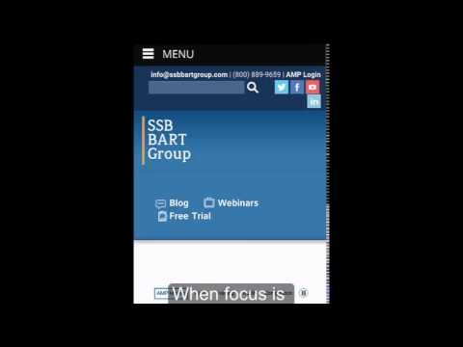
Switch for Android Devices
Settings > Accessibility > Switch Access > Settings
Notes:
25 Seconds

Slide 8
